Slide 1
M6

Slide 2


Water pollution
Water dissolves the fertilisers and pesticides that we use on our farms.
Sewage from our towns and cities and the waste from factories are also dumped into rivers or lakes.
Specific industries also use water for cooling in various operations and later return this hot water to water-bodies.
So some percentage of these substances are washed into the water
bodies.
Pesticides
Domestic sewage
Industrial sewage
Water pollution

Slide 3

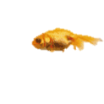
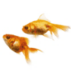
Water pollution
The water inside the deep reservoir would be colder than the water at the surface which gets heated by the Sun.
Another manner in which the temperature of the water in rivers can be affected is when water is released from dams.
This affects the balance between various organisms which
had been established in that system.

Slide 4

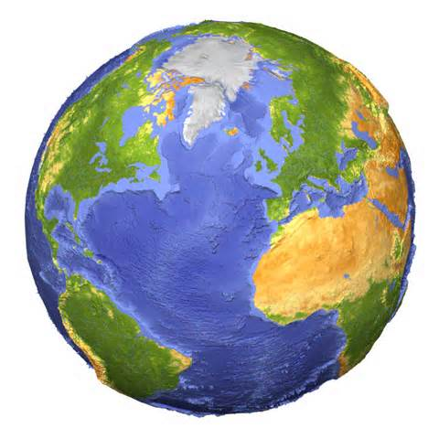
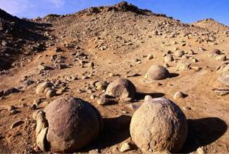
Mineral Riches in the Soil
Soil is an important resource that decides the diversity of life in an area
Crust
The outermost layer of our Earth is called the crust and the minerals found in this layer supply a variety of nutrients to life-forms.
But what is the
soil and how is it formed?
Crust is made up of rocks
Rocks
Minerals are bound up in rocks

